Slide 1
Devops – CI/CD
23-11-2020 to 27-11-2020
Venkatesh Reddy Madduri && ShankarPrasad

Slide 2
Agenda
Introduction
Git & GitHub
Continuous Integration using Jenkins
Introduction to Docker
Kubernetes
Ansible
Continuous Monitoring using Nagios
DevOps Project

Slide 3
What is Git
Git is a free, opensource distributed version control system tool designed to handle everything from small to very large projects with speed and efficiency.
It was created by Linus Torvalds in 2005 to develop Linux Kernel.
Git has the functionality, performance, security and flexibility that most teams and individual developers need.
It also serves as an important distributed version-control.
Git is a Distributed Version Control tool that supports distributed non-linear workflows by providing data assurance for developing quality software. Before you go ahead, check out this video on GIT which will give you better in-sight.
Notes:
Add docker icon

Slide 4
Purpose of Git & Version Control System
What is the purpose of Git?
Git is primarily used to manage your project, comprising a set of code/text files that may change.
But before we go further, let us take a step back to learn all about Version Control Systems (VCS) and how Git came into existence.
Version Control is the management of changes to documents, computer programs, large websites and other collection of information.
There are two types of VCS:
Centralized Version Control System (CVCS)
Distributed Version Control System (DVCS)
Notes:
Add docker icon

Slide 5
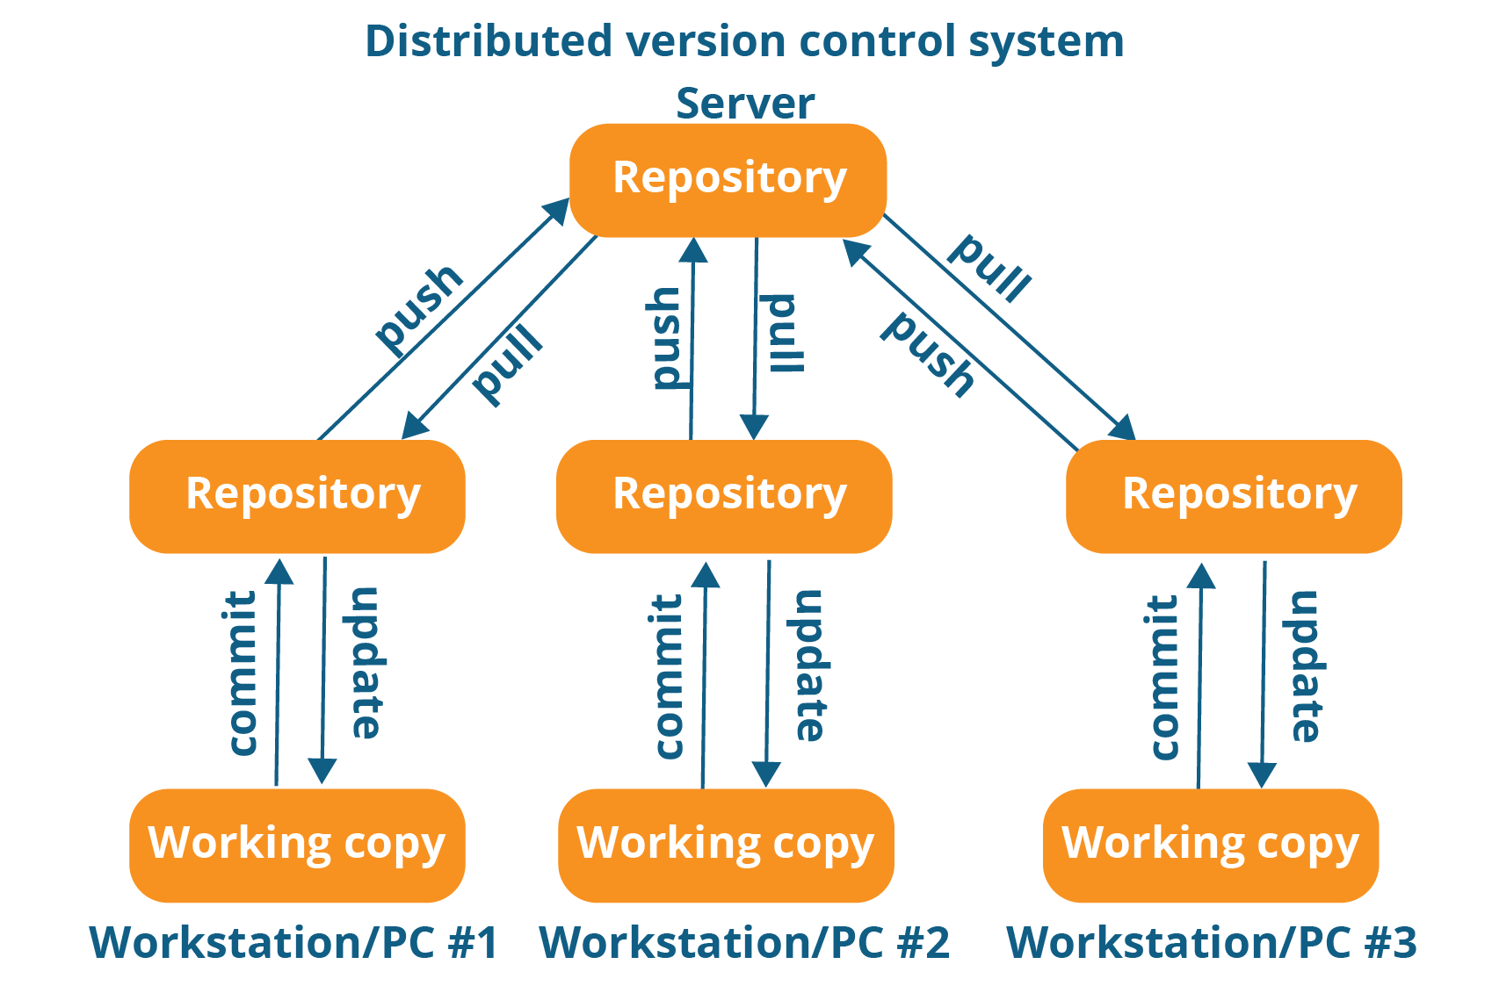
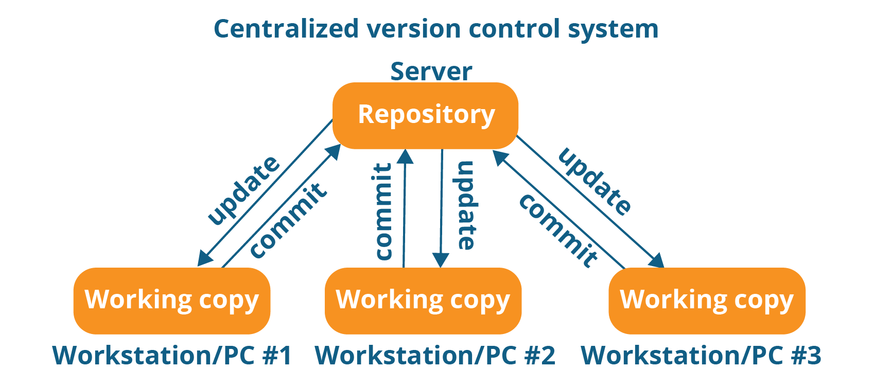
Centralized/Distributed VCS
Centralized version control system (CVCS) uses a central server to store all files and enables team collaboration. It works on a single repository to which users can directly access a central server.
Distributed VCS These systems do not necessarily rely on a central server to store all the versions of a project file. In Distributed VCS, every contributor has a local copy or “clone” of the main repository i.e. everyone maintains a local repository of their own which contains all the files and metadata present in the main repository.
Notes:
Add docker icon

Slide 6
Distributed VCS
These systems do not necessarily rely on a central server to store all the versions of a project file.
In Distributed VCS, every contributor has a local copy or “clone” of the main repository i.e. everyone maintains a local repository of their own which contains all the files and metadata present in the main repository.
Notes:
Add docker icon

Slide 7
Features Of Git
Free and open source -
Speed -
Scalable - The number of collaborators increase Git can easily handle this change.
Reliable - On the events of a system crash, the lost data can be recovered from any of the local repositories
Easy Branching -
Distributed development - Git gives each developer a local copy of the entire development history, and changes are copied from one such repository to another. These changes are imported as additional development branches, and can be merged in the same way as a locally developed branch
Compatibility with existing systems or protocol - Repositories can be published via http, ftp or a Git protocol over either a plain socket, or ssh. Git also has a Concurrent Version Systems (CVS) server emulation, which enables the use of existing CVS clients and IDE plugins to access Git repositories. Apache SubVersion (SVN) and SVK repositories can be used directly with Git-SVN.
Notes:
Add docker icon

Slide 8
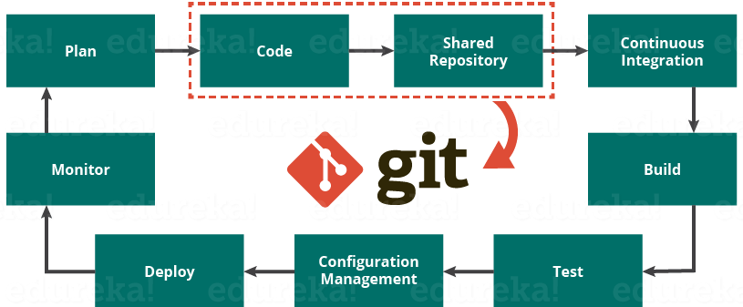
Role Of Git In DevOps
Notes:
Add docker icon

Slide 9
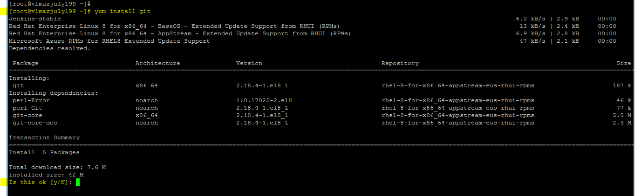
Git - Installation
sudo su –
git - - version
yum install git
Create a account in https://github.com/
Notes:
Add docker icon

Slide 10
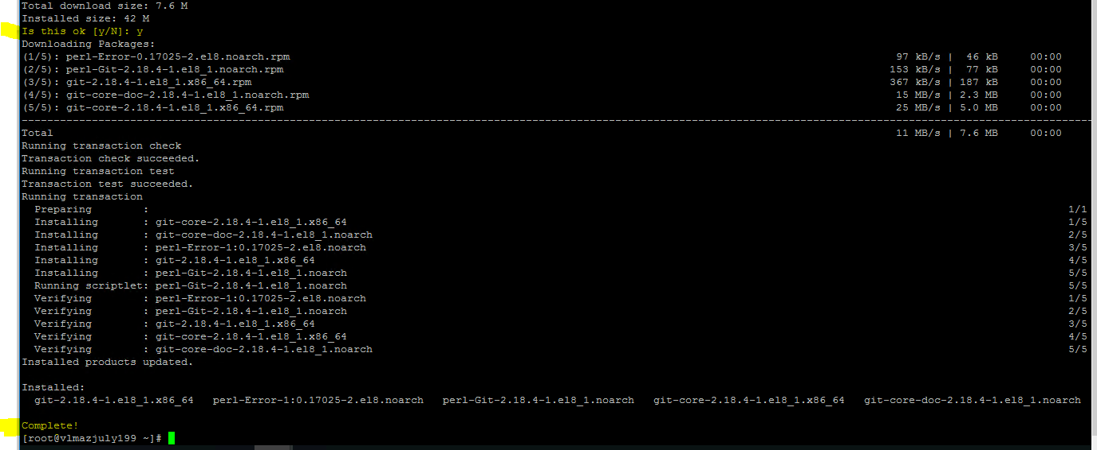
Git - Installation
Notes:
Add docker icon

Slide 11
Git - Commands
sudo su –
git - - version
yum install git
Create a account in https://github.com/
git config --global user.name shankarnj
git config --global user.email shankarnj@yahoo.com
Notes:
Add docker icon

Slide 12
Git - Commands
yum install git
git config --list
git config --global user.name shankarnj
git config --global user.email shankarnj@yahoo.com
git config --global --unset user.name
git config --global --unset user.email
git commit File1.txt
git commit -m "Pushed Updated File1.txt"
Notes:
Add docker icon

Slide 13
Git - Commands
git log
---- Check the current branch
git branch
---- add branch project1_b1
git branch project1_b1
---- add branch project1_b2
git branch project1_b2
---- add branch "project1_b3" and switch to "project1_b3"
git checkout -b project1_b3
---- create file_3.txt in b3 branch
echo 'New file in project1_b3 branch' > file_3.txt
Notes:
Add docker icon

Slide 14
Git - Commands
---- add file_3.txt in b3 branch at local repository
git add .
---- Commit the changes to local repository at branch project1_b3
git commit -m "commit the file file_3.txt in project1_b3 branch"
-- Switch to master
git checkout master
-- Verify the contents of master branch, you should see only master branch files
ls -ltr
Notes:
Add docker icon

Slide 15
Git - Commands
git remote add origin https://github.com/shankarnj/Project1.git
git remote -v
--To push the current branch and set the remote as upstream, use
git push origin master
Notes:
Add docker icon

Slide 16
Git - Commands
git push origin project1_b3
--Create a file "File3.txt"
git add File3.txt
git push origin master
git push origin master
git config --get remote.origin.url
Notes:
Add docker icon

Slide 17
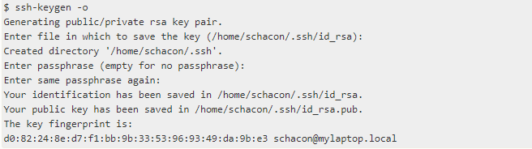
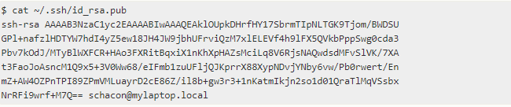
Git - SSh
Many Git servers authenticate using SSH public keys. In order to provide a public key, each user in your system must generate one if they don’t already have one. This process is similar across all operating systems. For more information, please check below link.
https://confluence.atlassian.com/bitbucketserver045/using-bitbucket-server/controlling-access-to-code/using-ssh-keys-to-secure-git-operations/creating-ssh-keys
Get the key
Notes:
Add docker icon

Slide 18
Git - SSh
Login into github.com
Click Profile and Settings
Click Add SSH and GPG Keys and the Key.
4. Try add new file and try to push and pull with your project.
Notes:
Add docker icon

Slide 19
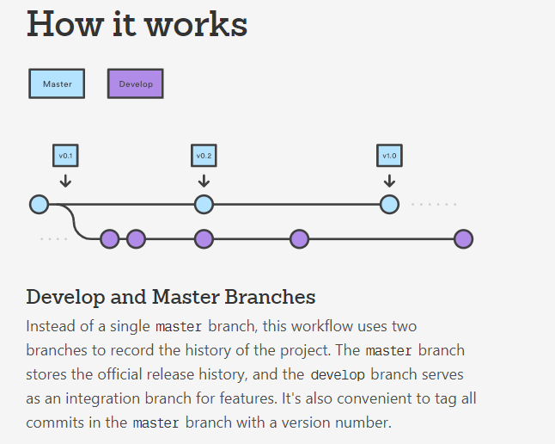
Git Flow
Gitflow Workflow is a Git workflow that helps with continuous software development and implementing DevOps practices. It was first published and made popular by Vincent Driessen at nvie. The Gitflow Workflow defines a strict branching model designed around the project release. This provides a robust framework for managing larger projects.
Notes:
Add docker icon

Slide 20
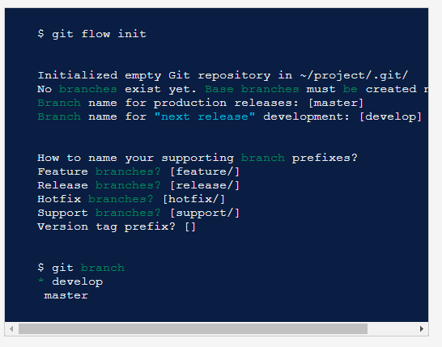
Git Flow
Gitflow Workflow is a Git workflow that helps with continuous software development and implementing DevOps practices. It was first published and made popular by Vincent Driessen at nvie. The Gitflow Workflow defines a strict branching model designed around the project release. This provides a robust framework for managing larger projects.
Notes:
Add docker icon

Slide 21
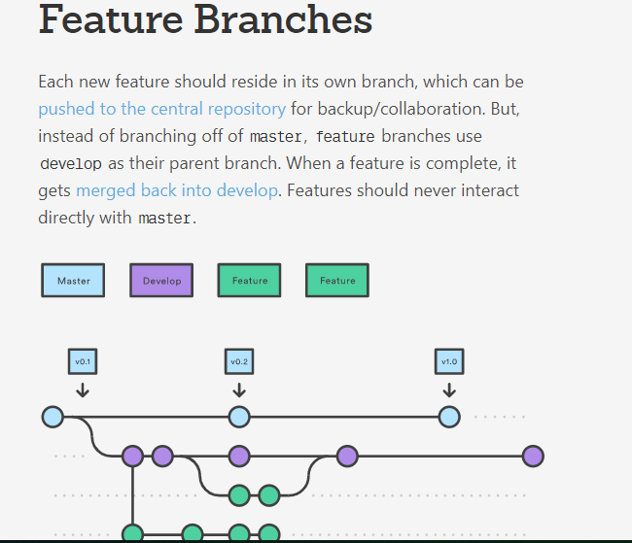
Notes:
Add docker icon

Slide 22
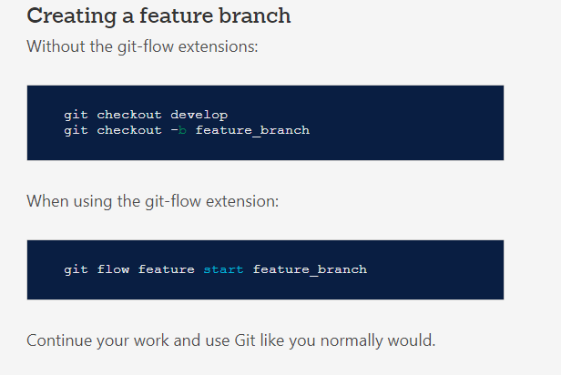
Notes:
Add docker icon

Slide 23
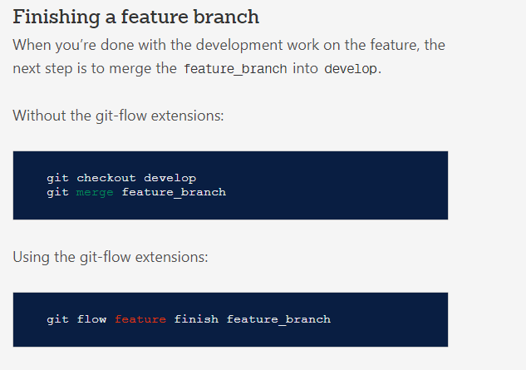
Notes:
Add docker icon

Slide 24
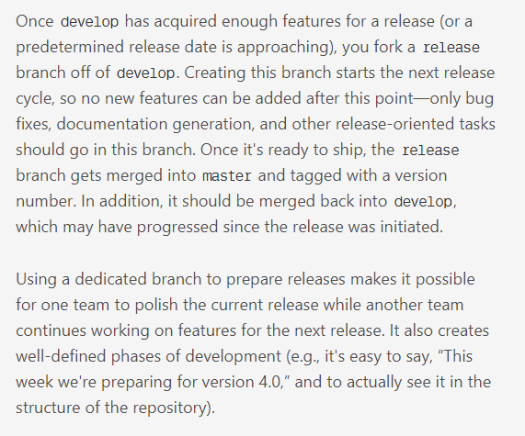
Releasing branch
Notes:
Add docker icon

Slide 25
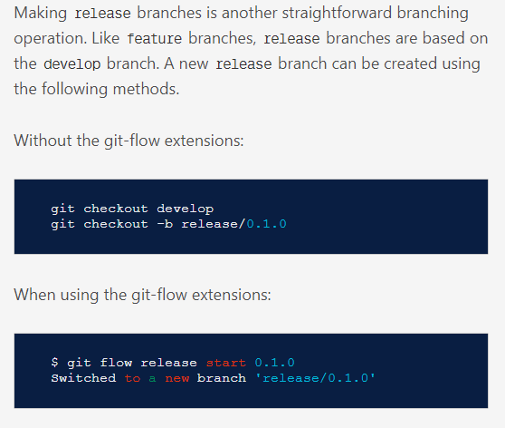
Notes:
Add docker icon

Slide 26
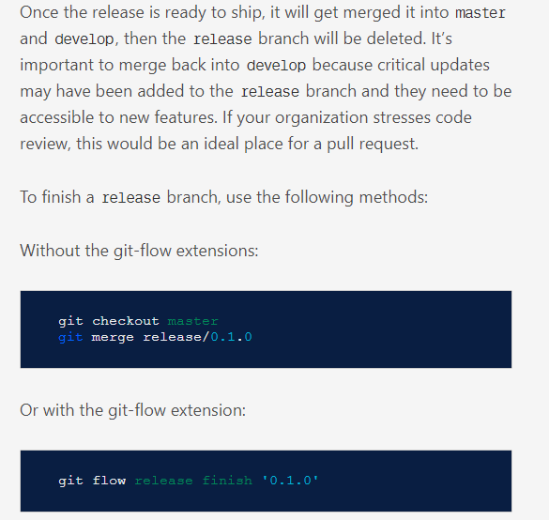
Notes:
Add docker icon

Slide 27
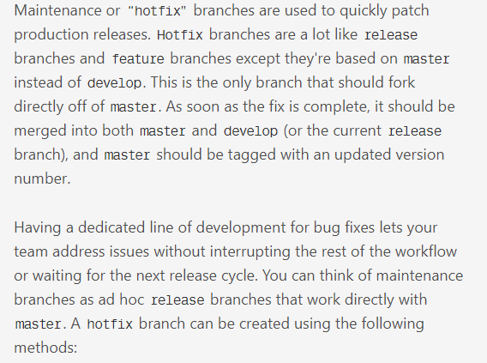
Hotfix Branches
Notes:
Add docker icon

Slide 28
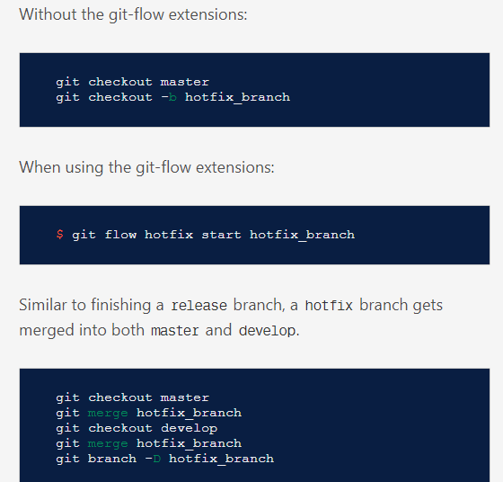
Hotfix Branches
Notes:
Add docker icon

Slide 29
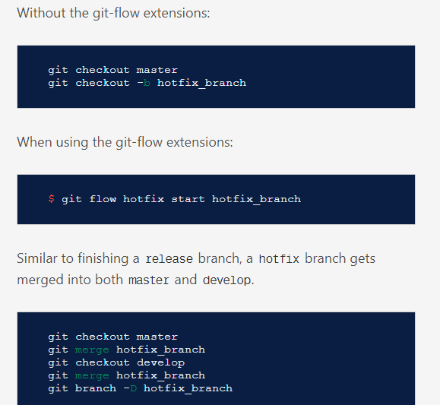
Hotfix Branches
Notes:
Add docker icon

Slide 30
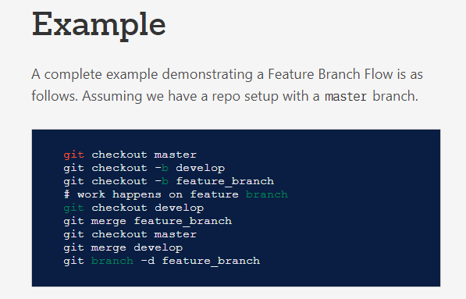
Hotfix Branches
Notes:
Add docker icon

Slide 31
Git rebase and merge operations
Notes:
Add docker icon

Slide 32

Thank you

